Slide 1
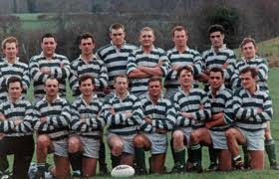
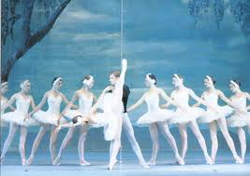
COMP24111 lecture 2
Rugby players, Ballet dancers,
and the
Nearest Neighbour Classifier

Slide 2
A Problem to Solve with Machine Learning
Distinguish rugby players from ballet dancers.
You are provided with a few examples.
Fallowfield rugby club (16).
Rusholme ballet troupe (10).
Task
Generate a program which will correctly classify ANY player/dancer in the world.
Hint
We shouldn’t “fine-tune” our system too much so it only works on the local clubs.

Slide 3
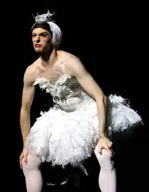
Taking measurements….
We have to process the people with a computer, so it needs to be in a computer-readable form.
What are the distinguishing characteristics?
Height
Weight
Shoe size
Sex

Slide 4
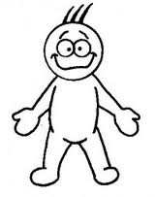
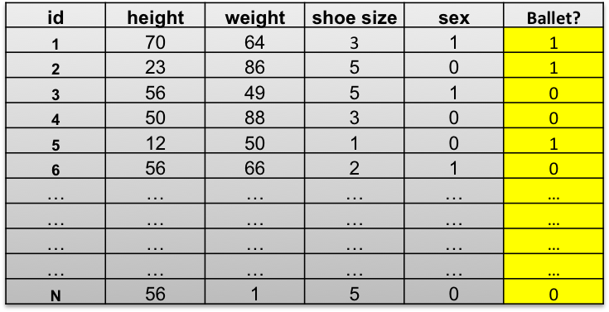
Terminology
“Examples”
“Features”
Class, or “label”

Slide 5
The Supervised Learning Pipeline
Training data
and labels
Learning algorithm
Testing Data
(no labels)
Model
Predicted Labels

Slide 6
Taking measurements….
Person
1
2
3
4
5
…
16
17
18
19
20
…
Weight
63kg
55kg
75kg
50kg
57kg
…
85kg
93kg
75kg
99kg
100kg
…
Height
190cm
185cm
202cm
180cm
174cm
150cm
145cm
130cm
163cm
171cm
height
weight

Slide 7
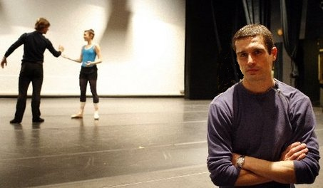
The Nearest Neighbour Rule
Person
1
2
3
4
5
…
16
17
18
19
20
…
Weight
63kg
55kg
75kg
50kg
57kg
…
85kg
93kg
75kg
99kg
100kg
…
Height
190cm
185cm
202cm
180cm
174cm
150cm
145cm
130cm
163cm
171cm
height
“TRAINING” DATA
weight
“TESTING” DATA
Who’s this guy?
- player or dancer?
height = 180cm
weight = 78kg

Slide 8
The Nearest Neighbour Rule
Person
1
2
3
4
5
…
16
17
18
19
20
…
Weight
63kg
55kg
75kg
50kg
57kg
…
85kg
93kg
75kg
99kg
100kg
…
Height
190cm
185cm
202cm
180cm
174cm
150cm
145cm
130cm
163cm
171cm
height
“TRAINING” DATA
weight
Find nearest neighbour
Assign the same class
height = 180cm
weight = 78kg

Slide 9
Supervised Learning Pipeline for Nearest Neighbour
Training data
Learning algorithm
(do nothing)
Testing Data
(no labels)
Model
(memorize the training data)
Predicted Labels

Slide 10
The K-Nearest Neighbour Classifier
Person
1
2
3
4
5
…
16
17
18
19
20
…
Weight
63kg
55kg
75kg
50kg
57kg
…
85kg
93kg
75kg
99kg
100kg
…
Height
190cm
185cm
202cm
180cm
174cm
150cm
145cm
130cm
163cm
171cm
Testing point x
For each training datapoint x’
measure distance(x,x’)
End
Sort distances
Select K nearest
Assign most common class
“TRAINING” DATA
height
weight

Slide 11
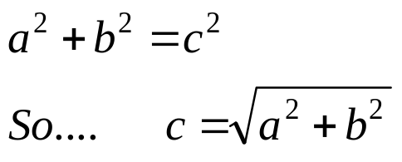
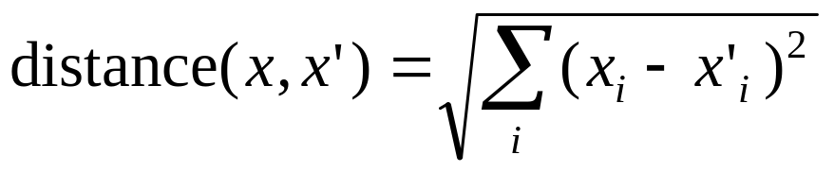
Quick reminder: Pythagoras’ theorem
. . .
measure distance(x,x’)
. . .
a
a.k.a. “Euclidean” distance
b
c
height
weight

Slide 12
The K-Nearest Neighbour Classifier
Person
1
2
3
4
5
…
16
17
18
19
20
…
Weight
63kg
55kg
75kg
50kg
57kg
…
85kg
93kg
75kg
99kg
100kg
…
Height
190cm
185cm
202cm
180cm
174cm
150cm
145cm
130cm
163cm
171cm
Testing point x
For each training datapoint x’
measure distance(x,x’)
End
Sort distances
Select K nearest
Assign most common class
“TRAINING” DATA
height
Seems sensible.
But what are the disadvantages?
weight

Slide 13
The K-Nearest Neighbour Classifier
Person
1
2
3
4
5
…
16
17
18
19
20
…
Weight
63kg
55kg
75kg
50kg
57kg
…
85kg
93kg
75kg
99kg
100kg
…
Height
190cm
185cm
202cm
180cm
174cm
150cm
145cm
130cm
163cm
171cm
height
“TRAINING” DATA
weight
Here I chose k=3.
What would happen if I chose k=5?
What would happen if I chose k=26?

Slide 14
The K-Nearest Neighbour Classifier
Person
1
2
3
4
5
…
16
17
18
19
20
…
Weight
63kg
55kg
75kg
50kg
57kg
…
85kg
93kg
75kg
99kg
100kg
…
Height
190cm
185cm
202cm
180cm
174cm
150cm
145cm
130cm
163cm
171cm
height
“TRAINING” DATA
weight
Any point on the left of this “boundary” is closer to the red circles.
Any point on the right of this “boundary” is closer to the blue crosses.
This is called the “decision boundary”.

Slide 15
Where’s the decision boundary?
height
weight
Not always a simple straight line!

Slide 16
Where’s the decision boundary?
height
weight
Not always contiguous!

Slide 17
The most important concept in Machine Learning

Slide 18
The most important concept in Machine Learning
Looks good so far…

Slide 19
The most important concept in Machine Learning
Looks good so far…
Oh no! Mistakes!
What happened?

Slide 20
The most important concept in Machine Learning
Looks good so far…
Oh no! Mistakes!
What happened?
We didn’t have all the data.
We can never assume that we do.
This is called “OVER-FITTING”
to the small dataset.

Slide 21
So, we have our first “machine learning” algorithm… ?
The K-Nearest Neighbour Classifier
Testing point x
For each training datapoint x’
measure distance(x,x’)
End
Sort distances
Select K nearest
Assign most common class
Make your own notes on its advantages / disadvantages.
I will ask for volunteers next time we meet…..

Slide 22
Pretty dumb! Where’s the learning!
Training data
Learning algorithm
(do nothing)
Testing Data
(no labels)
Model
(memorize the training data)
Predicted Labels

Slide 23
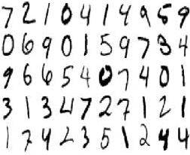
Now, how is this problem like handwriting recognition?
height
weight

Slide 24

Let’s say the measurements are pixel values.
A two-pixel image
255
pixel 2 value
(190, 85)
0
0
255
pixel 1 value

Slide 25
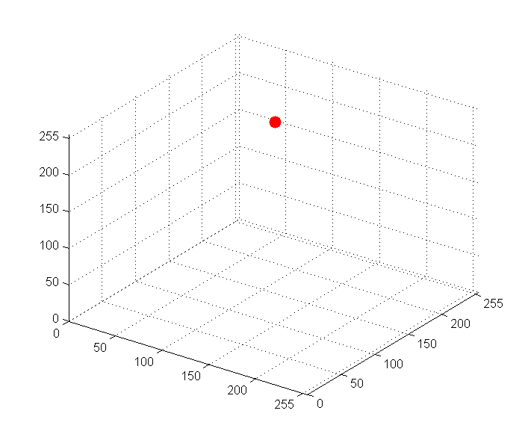
Three dimensions…
A three-pixel image
(190, 85, 202)
pixel 1
pixel 2
pixel 3
This 3-pixel image is represented by
a SINGLE point in a 3-D space.

Slide 26
Distance between images
A three-pixel image
(190, 85, 202)
Another 3-pixel image
pixel 1
(25, 150, 75)
pixel 2
pixel 3
Straight line distance between them?

Slide 27
4-dimensional space? 5-d? 6-d?
A three-pixel image
A four-pixel image.
(190, 85, 202)
A five-pixel image
pixel 1
pixel 2
pixel 3

Slide 28
A four-pixel image.
A different four-pixel image.
(190, 85, 202, 10)
(190, 85, 202, 10)
Same 4-dimensional vector!
Assuming we read pixels in a systematic manner, we can now represent any image as a single point in a high dimensional space.

Slide 29

16 x 16 pixel image. How many dimensions?

Slide 30
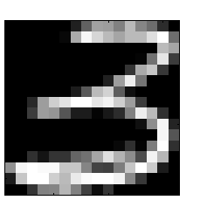
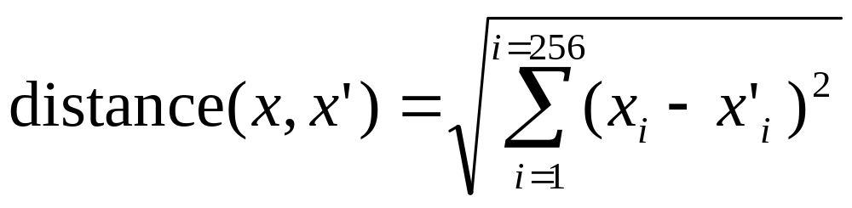
We can measure distance in 256 dimensional space.
?

Slide 31
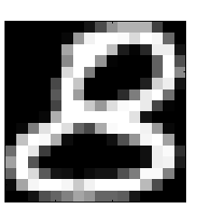
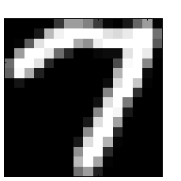
Which is the nearest neighbour to our ‘3’ ?
maybe
maybe
probably
not

Slide 32


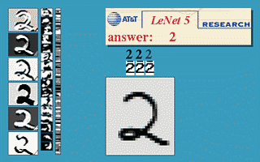
AT&T Research Labs
The USPS postcode reader – learnt from examples.
FAST recognition
NOISE resistant, can generalise to future unseen patterns

Slide 33

Your lab exercise
Use K-NN to recognise handwritten USPS digits.
Final lab session before reading week.
(see website for details)
i.e. you have 4 weeks.
Biggest mistake by students in last year’s class?
…starting 2 weeks from now!

